Slide 1


Slide 2
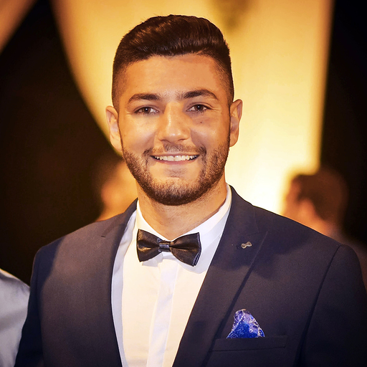
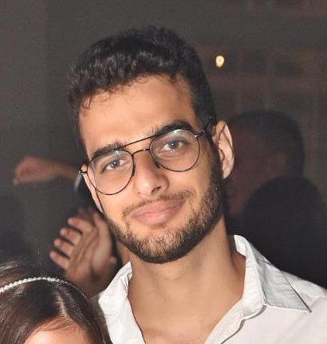

The Team
Amit Aharoni
26, Pardesiya
3rd year C.S. student
Knowledge in C#, JavaScript, C++
Sports fan, likes solving problems
GitHub: AmitAharoni
Nadav Suliman
26, Ra’anana
3rd year C.S. student
Knowledge in Java, JavaScript, HTML/CSS
Likes basketball, CTFs, Gaming
GitHub: nadavsu
Tamir Houri
26, Ramat Gan
2nd year C.S. student
Knowledge in C++, C, Python, HTML
Likes running, watching Netflix, diving
GitHub: Tamirho

Slide 3
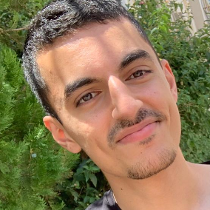

The Team
Daniel Malky
23, Holon
2nd year C.S. student
Knowledge in C, C++, Python
Likes movies & snooker
GitHub: DanielMy777
Micha Levy
24, Modi’in
2nd year C.S. student
Knowledge in C, C++
Likes watching Netflix
GitHub: Micha546

Slide 4
Model & Model function testing
Visual presentation of the main tests

Slide 5
Login & Logout
Video demonstration of features
from a user’s point of view.
Manual tests
Automated tests (+ failed scenarios )
Demonstration on GitHub actions.

Slide 6

Login & Logout

Slide 7
Update apartment
Video demonstration of features
from a user’s point of view.
Manual tests
Automated tests (+ failed scenarios )
Demonstration on GitHub actions.

Slide 8

Update apartment

Slide 9
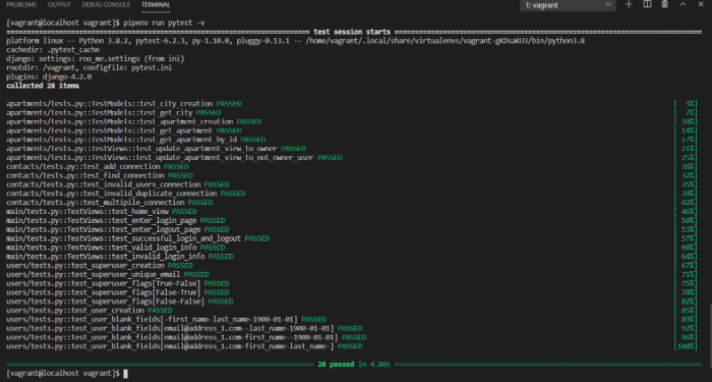
Tests via local machine

Slide 10
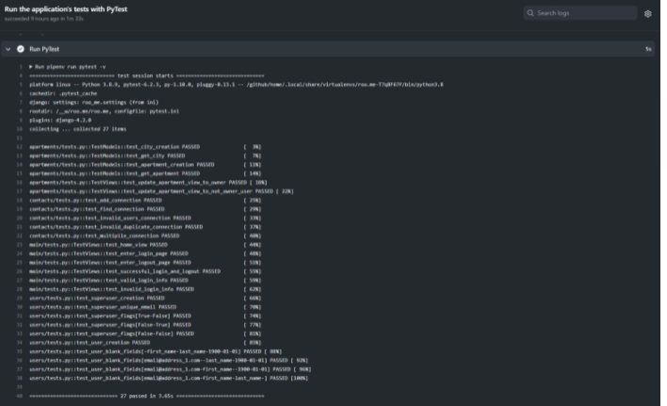
Tests via CI

